Slide 1
D-STAR InfoCon 2016 at Dayton Hamvention
Part 2 – Using D-STAR
John Davis WB4QDX

Slide 2
Getting on the Air
FM Repeater
  Mode - FM
  Frequency
  Offset
  CTCSS / TSQ
  Tone frequency
D-STAR Repeater
  Mode - DV
  Frequency
  Offset
  UR
  RPT1
  RPT2

Slide 3
The Big Three
MY or MYCALL is your own callsign and is set once in radio
UR or URCALL: Where do I want to go?
RPT1: The repeater and module I am transmitting to (ex. KJ4GGV C)
RPT2: Where I want my transmission to go (normally to “G”, the Gateway)
    NOTE: It’s a good practice to put the callsign and “G” in RPT2 even if talking local so other linked repeaters, DV Dongles and DV Access Points can hear your transmissions

Slide 4
RPT1, RPT2 Format
Normal format (xxnxxx m)
    Callsign is left justified
    Module is always in 8th position
        C=VHF
        B=UHF
        A=1.2 GHz
Examples ("▪" represents a space )
    WD4STR▪C
    W4DOC▪▪C
    W4GR▪▪▪C

Slide 5
Basic QSO
Sample for KJ4GGV VHF/2m Repeater
145.2800 MHz +5.0 MHz Offset
  MY WB4QDX
  UR CQCQCQ
  RPT1 KJ4GGV▪C
  RPT2 KJ4GGV▪G
"▪" represents a space
Used for talking on local repeater. If repeater is linked, you are also heard on any of the linked repeaters
5

Slide 6
Linking to a Repeater
Sample for KJ4GGV VHF/2m Repeater
145.2800 MHz +5.0 MHz Offset
  MY WB4QDX
  UR WX4GPBAL (or W4DOC▪CL, W4GR▪▪CL)
  RPT1 KJ4GGV▪C
  RPT2 KJ4GGV▪G
"▪" represents a space
Key once, gateway responds with voice prompt “Remote System Linked”. Change to CQCQCQ in UR for QSO.
6

Slide 7
Linking to a Reflector
Sample for KJ4GGV VHF/2m Repeater
145.2800 MHz +5.0 MHz Offset
  MY WB4QDX
  UR REF002AL
  RPT1 KJ4GGV▪C
  RPT2 KJ4GGV▪G
"▪" represents a space
Key once, gateway responds with voice prompt “Remote System Linked”. Change to CQCQCQ in UR for QSO.
7

Slide 8
Unlinking
Sample for KJ4GGV VHF/2m Repeater
145.2800 MHz +5.0 MHz Offset
  MY WB4QDX
  UR ▪▪▪▪▪▪▪U
  RPT1 KJ4GGV▪C
  RPT2 KJ4GGV▪G
"▪" represents a space
Key once, gateway responds with unlinked voice prompt. Change to CQCQCQ in UR for QSO.
8

Slide 9
Memory Management
Radios have different capabilities and number of memories
First generation radios have standard memory locations for FM or DV
      Method 1 – Store commands in memory for favorite reflectors or repeaters
      Method 2 – Use UR memories for favorite reflectors or repeaters (uses fewer memory locations
Newer radios with DR mode simplify programming
      Method 3 – Use DR mode with repeater list and GPS for nearest repeater

Slide 10
Radio Memory Management – Method 1
Organize blocks of channels stored in memories:
Can be used with any D-STAR radio
Create a group or bank of memories for each repeater
Store commands for each function in a memory of the group
CH No | Frequency | Dup | Offset | TS | Mode | Name | Your Call Sign | RPT1 Call Sign | RPT2 Call Sign
1 | 145.200 | DUP- | 0.6 | 10kHz | DV | KI4SBA C | CQCQCQ | KI4SBA C | KI4SBA G
2 | 145.200 | DUP- | 0.6 | 10kHz | DV | UNLINK | U | KI4SBA C | KI4SBA G
3 | 145.200 | DUP- | 0.6 | 10kHz | DV | SBA C ID | I | KI4SBA C | KI4SBA G
4 | 145.200 | DUP- | 0.6 | 10kHz | DV | REF001C | REF001CL | KI4SBA C | KI4SBA G
5 | 145.200 | DUP- | 0.6 | 10kHz | DV | REF002A | REF002AL | KI4SBA C | KI4SBA G
6 | 145.200 | DUP- | 0.6 | 10kHz | DV | REF004A | REF004AL | KI4SBA C | KI4SBA G
7 | 145.200 | DUP- | 0.6 | 10kHz | DV | REF030A | REF030AL | KI4SBA C | KI4SBA G
8 | 145.200 | DUP- | 0.6 | 10kHz | DV | REF030B | REF030BL | KI4SBA C | KI4SBA G
9 | 145.200 | DUP- | 0.6 | 10kHz | DV | REF030C | REF030CL | KI4SBA C | KI4SBA G
10 | 145.200 | DUP- | 0.6 | 10kHz | DV | ECHOTEST | E | KI4SBA C | KI4SBA G

Slide 11
Radio Memory Management - Talk
Use this channel for general QSO
No linking commands required or repeater already linked
CQCQCQ in UR field
CH No | Frequency | Dup | Offset | TS | Mode | Name | Your Call Sign | RPT1 Call Sign | RPT2 Call Sign
1 | 145.200 | DUP- | 0.6 | 10kHz | DV | KI4SBA C | CQCQCQ | KI4SBA C | KI4SBA G
2 | 145.200 | DUP- | 0.6 | 10kHz | DV | UNLINK | U | KI4SBA C | KI4SBA G
3 | 145.200 | DUP- | 0.6 | 10kHz | DV | SBA C ID | I | KI4SBA C | KI4SBA G
4 | 145.200 | DUP- | 0.6 | 10kHz | DV | REF001C | REF001CL | KI4SBA C | KI4SBA G
5 | 145.200 | DUP- | 0.6 | 10kHz | DV | REF002A | REF002AL | KI4SBA C | KI4SBA G
6 | 145.200 | DUP- | 0.6 | 10kHz | DV | REF004A | REF004AL | KI4SBA C | KI4SBA G
7 | 145.200 | DUP- | 0.6 | 10kHz | DV | REF030A | REF030AL | KI4SBA C | KI4SBA G
8 | 145.200 | DUP- | 0.6 | 10kHz | DV | REF030B | REF030BL | KI4SBA C | KI4SBA G
9 | 145.200 | DUP- | 0.6 | 10kHz | DV | REF030C | REF030CL | KI4SBA C | KI4SBA G
10 | 145.200 | DUP- | 0.6 | 10kHz | DV | ECHOTEST | E | KI4SBA C | KI4SBA G

Slide 12
Radio Memory Management - ID
Use to see if repeater is linked or unlinked
If linked, repeater says “Remote system linked”
Data line will indicate where repeater or reflector linked
Return to CQCQCQ channel to talk
CH No | Frequency | Dup | Offset | TS | Mode | Name | Your Call Sign | RPT1 Call Sign | RPT2 Call Sign
1 | 145.200 | DUP- | 0.6 | 10kHz | DV | KI4SBA C | CQCQCQ | KI4SBA C | KI4SBA G
2 | 145.200 | DUP- | 0.6 | 10kHz | DV | UNLINK | U | KI4SBA C | KI4SBA G
3 | 145.200 | DUP- | 0.6 | 10kHz | DV | SBA C ID | I | KI4SBA C | KI4SBA G
4 | 145.200 | DUP- | 0.6 | 10kHz | DV | REF001C | REF001CL | KI4SBA C | KI4SBA G
5 | 145.200 | DUP- | 0.6 | 10kHz | DV | REF002A | REF002AL | KI4SBA C | KI4SBA G
6 | 145.200 | DUP- | 0.6 | 10kHz | DV | REF004A | REF004AL | KI4SBA C | KI4SBA G
7 | 145.200 | DUP- | 0.6 | 10kHz | DV | REF030A | REF030AL | KI4SBA C | KI4SBA G
8 | 145.200 | DUP- | 0.6 | 10kHz | DV | REF030B | REF030BL | KI4SBA C | KI4SBA G
9 | 145.200 | DUP- | 0.6 | 10kHz | DV | REF030C | REF030CL | KI4SBA C | KI4SBA G
10 | 145.200 | DUP- | 0.6 | 10kHz | DV | ECHOTEST | E | KI4SBA C | KI4SBA G

Slide 13
Radio Memory Management - Link
Tune to channel and key briefly to initiate link command
System will say “Remote system linked” if successful
Return to CQCQCQ channel to talk
CH No | Frequency | Dup | Offset | TS | Mode | Name | Your Call Sign | RPT1 Call Sign | RPT2 Call Sign
1 | 145.200 | DUP- | 0.6 | 10kHz | DV | KI4SBA C | CQCQCQ | KI4SBA C | KI4SBA G
2 | 145.200 | DUP- | 0.6 | 10kHz | DV | UNLINK | U | KI4SBA C | KI4SBA G
3 | 145.200 | DUP- | 0.6 | 10kHz | DV | SBA C ID | I | KI4SBA C | KI4SBA G
4 | 145.200 | DUP- | 0.6 | 10kHz | DV | REF001C | REF001CL | KI4SBA C | KI4SBA G
5 | 145.200 | DUP- | 0.6 | 10kHz | DV | REF002A | REF002AL | KI4SBA C | KI4SBA G
6 | 145.200 | DUP- | 0.6 | 10kHz | DV | REF004A | REF004AL | KI4SBA C | KI4SBA G
7 | 145.200 | DUP- | 0.6 | 10kHz | DV | REF030A | REF030AL | KI4SBA C | KI4SBA G
8 | 145.200 | DUP- | 0.6 | 10kHz | DV | REF030B | REF030BL | KI4SBA C | KI4SBA G
9 | 145.200 | DUP- | 0.6 | 10kHz | DV | REF030C | REF030CL | KI4SBA C | KI4SBA G
10 | 145.200 | DUP- | 0.6 | 10kHz | DV | ECHOTEST | E | KI4SBA C | KI4SBA G

Slide 14
Radio Memory Management - Unlink
Tune to channel and key briefly to initiate link command
System will say “Remote system unlinked” if successful
Return to CQCQCQ channel to talk
CH No | Frequency | Dup | Offset | TS | Mode | Name | Your Call Sign | RPT1 Call Sign | RPT2 Call Sign
1 | 145.200 | DUP- | 0.6 | 10kHz | DV | KI4SBA C | CQCQCQ | KI4SBA C | KI4SBA G
2 | 145.200 | DUP- | 0.6 | 10kHz | DV | UNLINK | U | KI4SBA C | KI4SBA G
3 | 145.200 | DUP- | 0.6 | 10kHz | DV | SBA C ID | I | KI4SBA C | KI4SBA G
4 | 145.200 | DUP- | 0.6 | 10kHz | DV | REF001C | REF001CL | KI4SBA C | KI4SBA G
5 | 145.200 | DUP- | 0.6 | 10kHz | DV | REF002A | REF002AL | KI4SBA C | KI4SBA G
6 | 145.200 | DUP- | 0.6 | 10kHz | DV | REF004A | REF004AL | KI4SBA C | KI4SBA G
7 | 145.200 | DUP- | 0.6 | 10kHz | DV | REF030A | REF030AL | KI4SBA C | KI4SBA G
8 | 145.200 | DUP- | 0.6 | 10kHz | DV | REF030B | REF030BL | KI4SBA C | KI4SBA G
9 | 145.200 | DUP- | 0.6 | 10kHz | DV | REF030C | REF030CL | KI4SBA C | KI4SBA G
10 | 145.200 | DUP- | 0.6 | 10kHz | DV | ECHOTEST | E | KI4SBA C | KI4SBA G

Slide 15
Radio Memory Management - Echotest
Tune to channel, key and speak
System will echo back your transmission
Return to CQCQCQ channel to talk
CH No | Frequency | Dup | Offset | TS | Mode | Name | Your Call Sign | RPT1 Call Sign | RPT2 Call Sign
1 | 145.200 | DUP- | 0.6 | 10kHz | DV | KI4SBA C | CQCQCQ | KI4SBA C | KI4SBA G
2 | 145.200 | DUP- | 0.6 | 10kHz | DV | UNLINK | U | KI4SBA C | KI4SBA G
3 | 145.200 | DUP- | 0.6 | 10kHz | DV | SBA C ID | I | KI4SBA C | KI4SBA G
4 | 145.200 | DUP- | 0.6 | 10kHz | DV | REF001C | REF001CL | KI4SBA C | KI4SBA G
5 | 145.200 | DUP- | 0.6 | 10kHz | DV | REF002A | REF002AL | KI4SBA C | KI4SBA G
6 | 145.200 | DUP- | 0.6 | 10kHz | DV | REF004A | REF004AL | KI4SBA C | KI4SBA G
7 | 145.200 | DUP- | 0.6 | 10kHz | DV | REF030A | REF030AL | KI4SBA C | KI4SBA G
8 | 145.200 | DUP- | 0.6 | 10kHz | DV | REF030B | REF030BL | KI4SBA C | KI4SBA G
9 | 145.200 | DUP- | 0.6 | 10kHz | DV | REF030C | REF030CL | KI4SBA C | KI4SBA G
10 | 145.200 | DUP- | 0.6 | 10kHz | DV | ECHOTEST | E | KI4SBA C | KI4SBA G

Slide 16

Memory Management –
Method 2
Can be used with any D-STAR radio
Program one memory location per repeater with CQCQCQ in UR field
Utilize “Your Call Sign” memories for UR field
Select Memory location and change UR field for favorite linking command

Slide 17
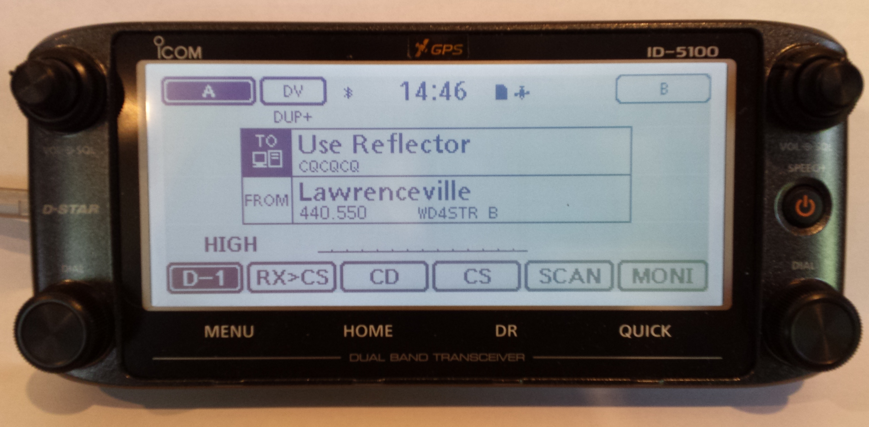
Memory Management –
Method 3 (DR Mode)
Available on ID-31, ID51, IC-7100, ID-5100
Radios have regular memories usually used for FM
Geocoded Repeater List / DR memories used for D-STAR
ID-51A (Anniversary Edition or Plus) and ID-5100 Repeater List may be used for FM or D-STAR
DR Mode introduces TO/FROM screen for easy use

Slide 18
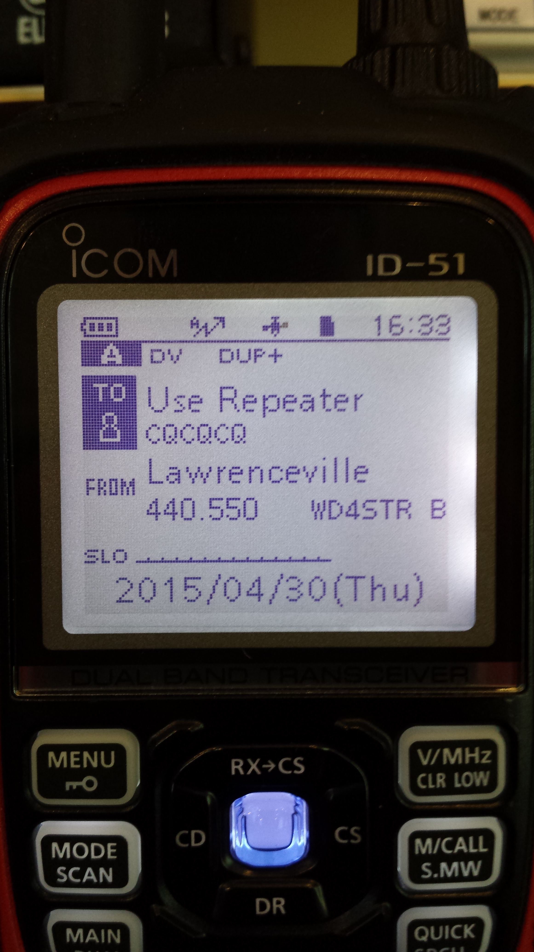
DR Mode – Easiest to Use
DR Mode is Digital Repeater Mode
Current generation of radios have two sets of memories
  Regular Memories for traditional frequency storage
  Repeater List is geocoded for location-based lookup
Easy to Use
  Press DR
  Select Source Repeater in FROM field
    Pick by region
    Find Nearest Repeater to current location
  Select function in TO field
Automatic Programming of Radio

Slide 19

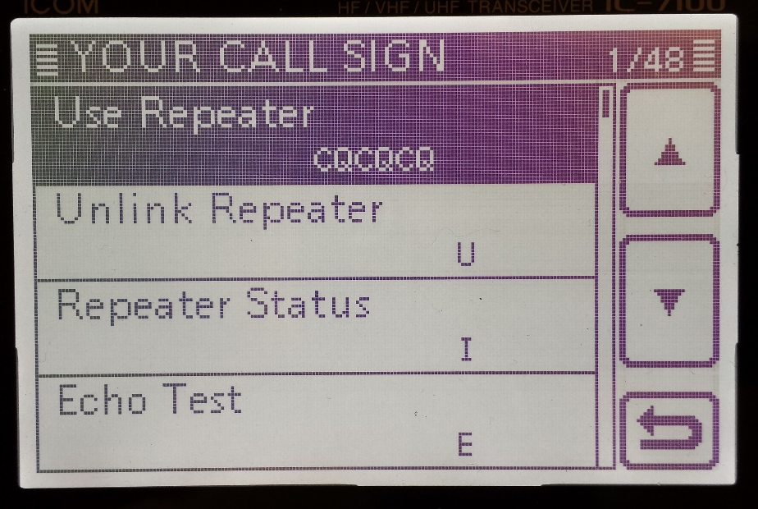
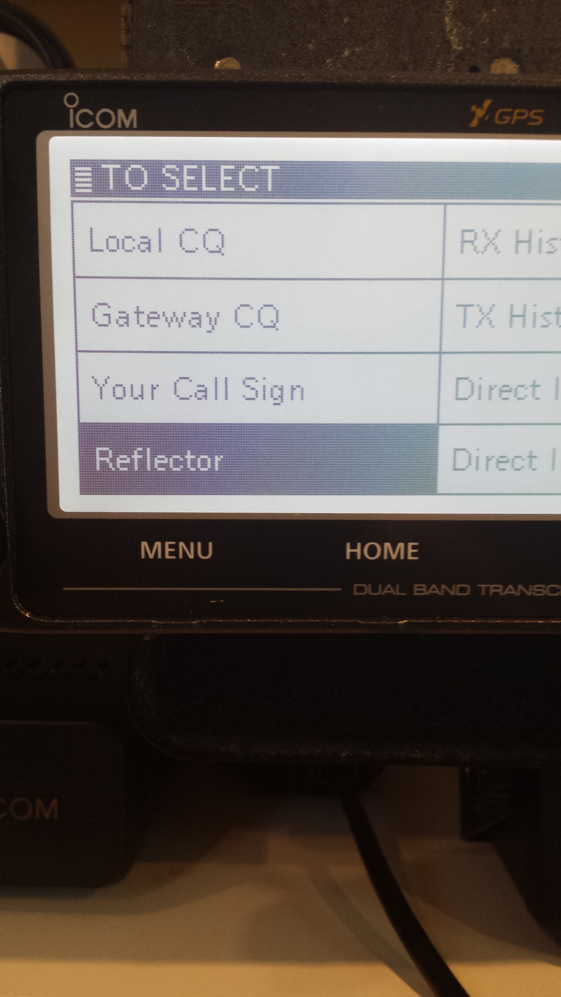
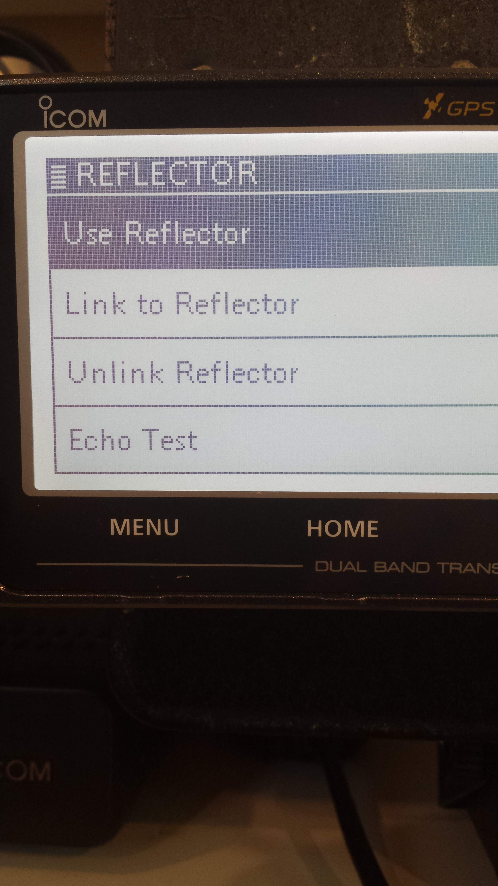
Which CQ?
Select TO on screen
DO NOT USE Local CQ
  Shows as CQCQCQ
3rd Generation (ID-31, ID-51, ID-7100)
  Select “Your Call Sign”
  Select “Use Repeater” to talk
3rd + Generation (ID-51+, ID-5100)
  Select (“Reflector”)
  Select (“Use Reflector”) to talk

Slide 20
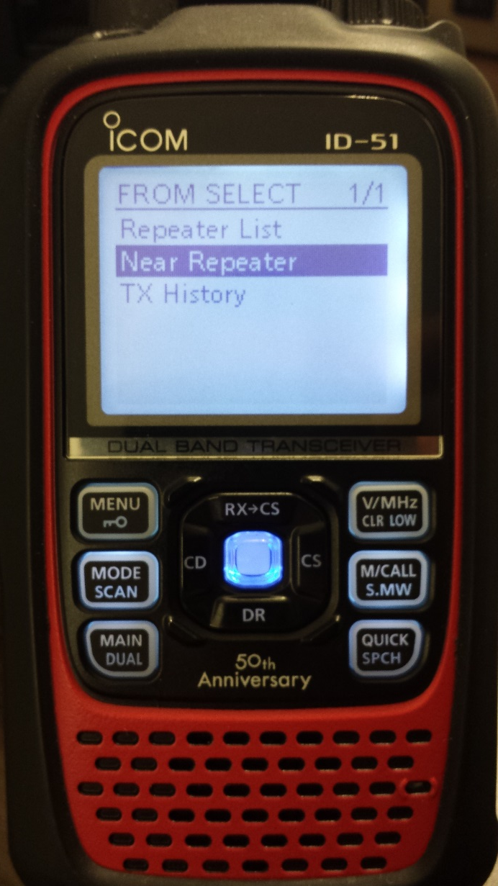
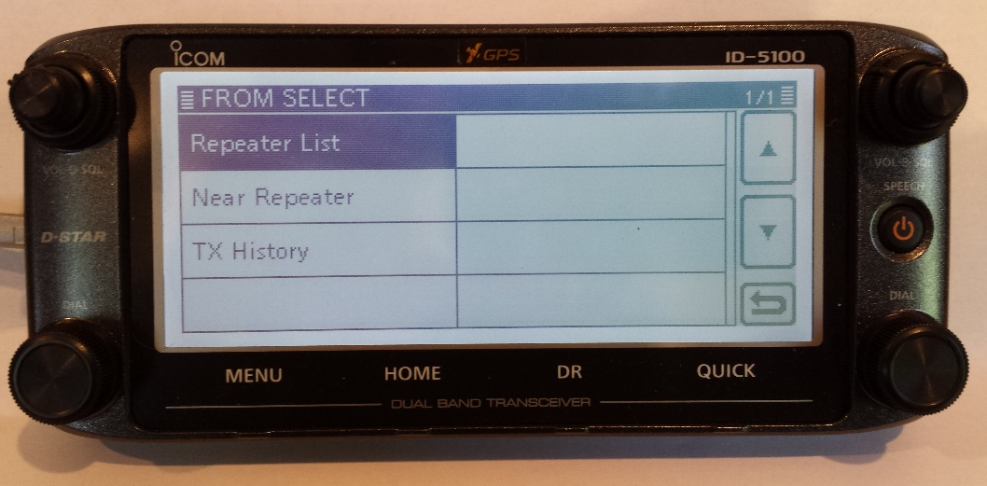
What Repeater?
Select FROM field:
Repeater List shows region, then list of repeaters
Near Repeater uses built-in GPS to show list of nearest repeaters

Slide 21
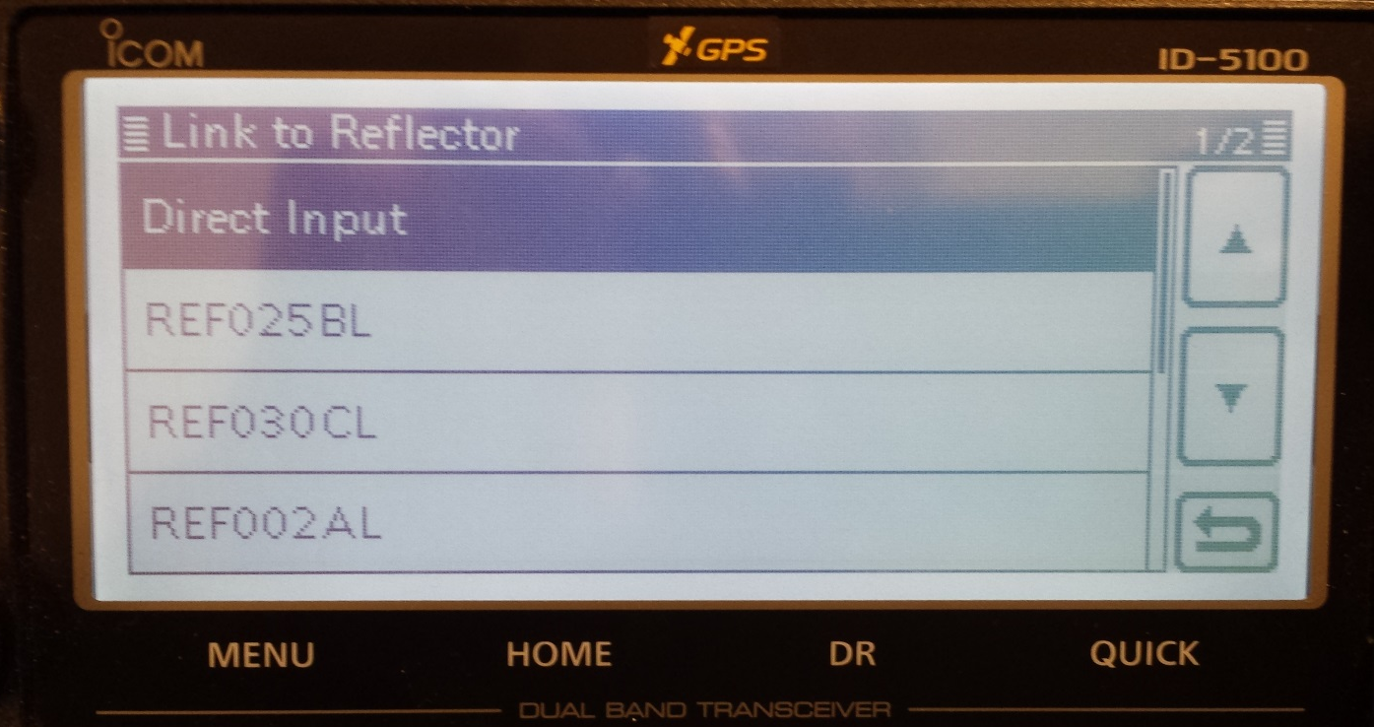
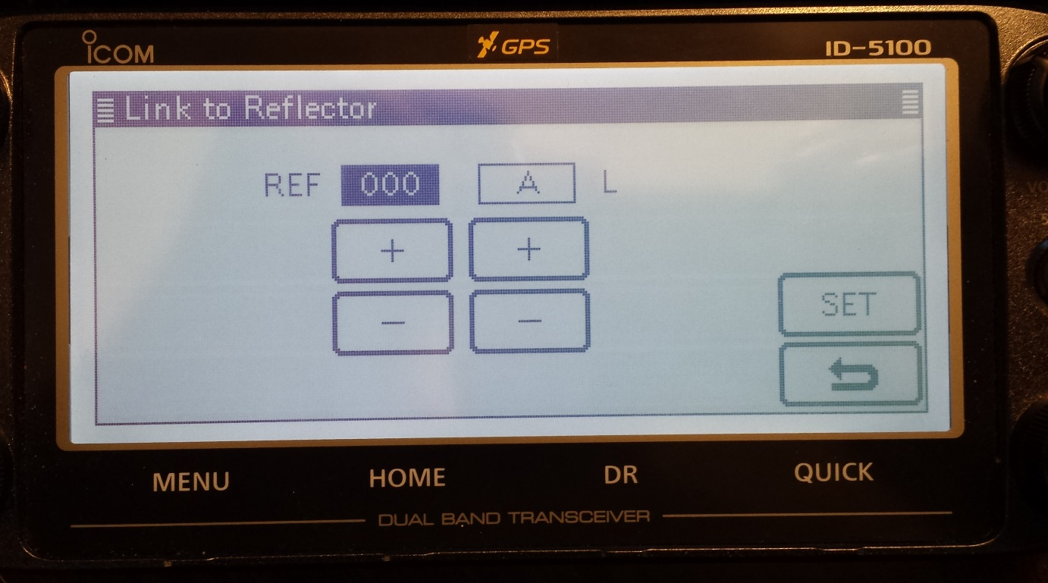
Linking to Reflectors
To link to a Reflector, select Reflector, Link to Reflector, Direct Input, then select Reflector and Module
Once a Reflector has been selected, it’s listed for quick selection

Slide 22
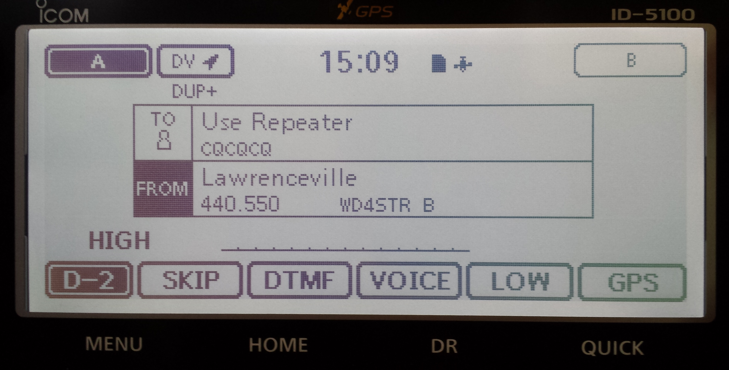
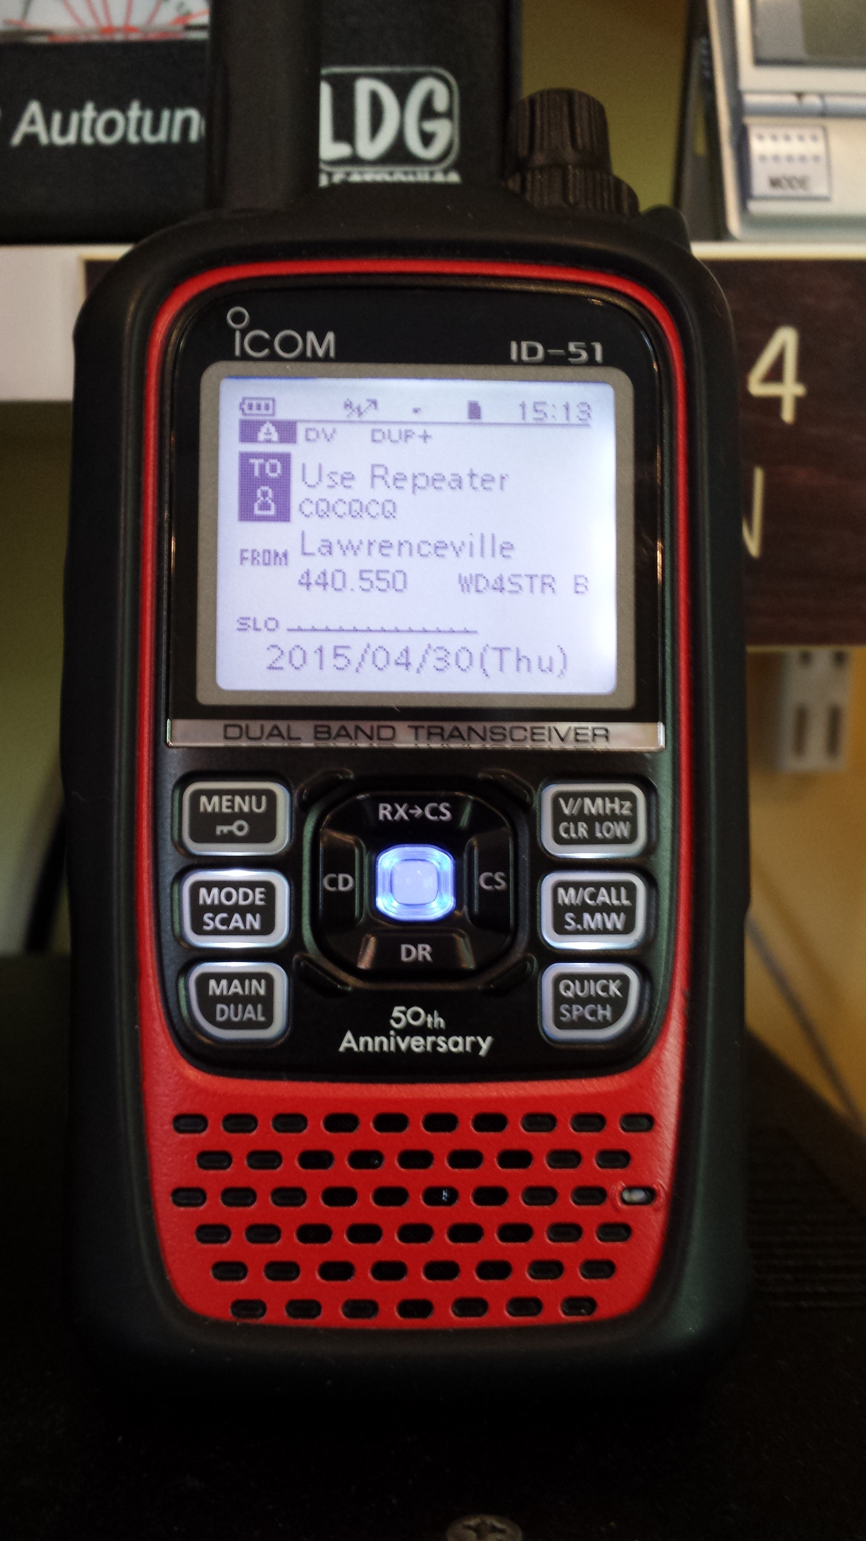
Normal DR Mode Talk Display

Slide 23
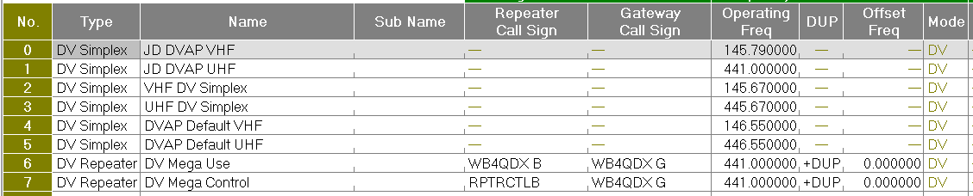
Programming for a DVAP / DV Mega
Can be programmed to standard memories
Use DR Memories (Repeater List) for later models
Allows using TO field to select linking and other functions
CH No | Frequency | Dup | Offset | TS | Mode | Name | Your Call Sign | RPT1 Call Sign | RPT2 Call Sign
1 | 145.200 | Simp | 0.0 | 10kHz | DV | KI4SBA C | CQCQCQ | DIRECT
2 | 145.200 | Simp | 0.0 | 10kHz | DV | UNLINK | U | DIRECT
3 | 145.200 | Simp | 0.0 | 10kHz | DV | SBA C ID | I | DIRECT
4 | 145.200 | Simp | 0.0 | 10kHz | DV | REF001C | REF030CL | DIRECT

Slide 24
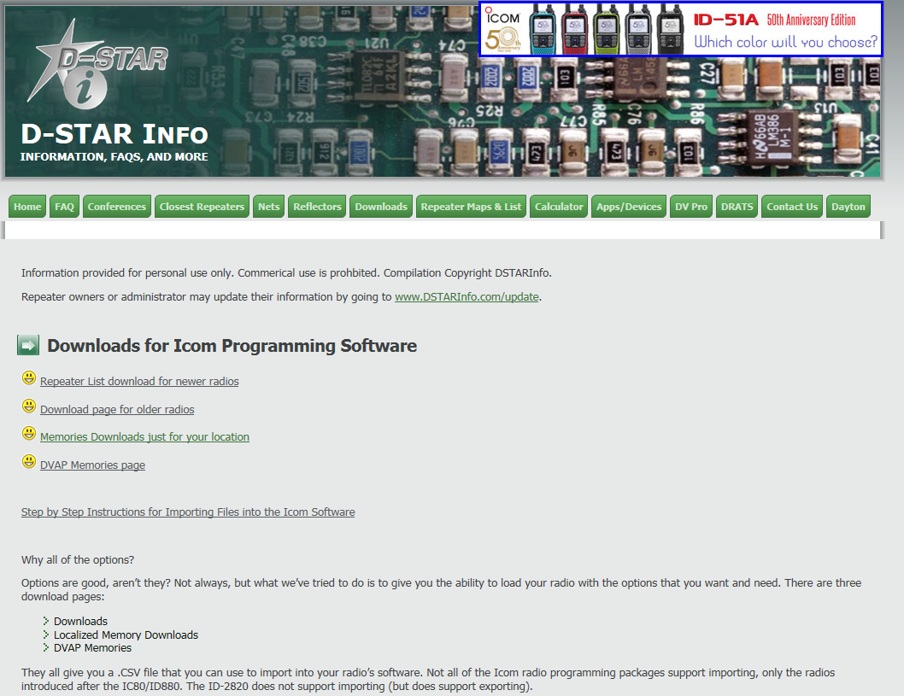
Updating Radio Memory
Customized, localized download files available at www.DSTARinfo.com
Creates CSV files to import to most Icom radios
Create updated geocoded Repeater List for DR Mode
Build DVAP Memories

Slide 25
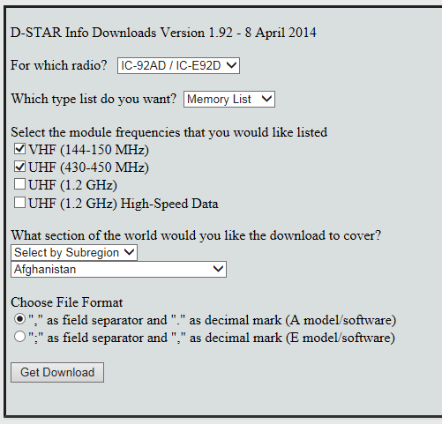
Standard Memory Download
Select Downloads, Old Downloads for ID-80, ID-880, ID-92 and all newer radios
Select options
Creates CSV file
Import into radio using Icom programming software
Edit file size in Excel to <100 entries to import by memory group

Slide 26
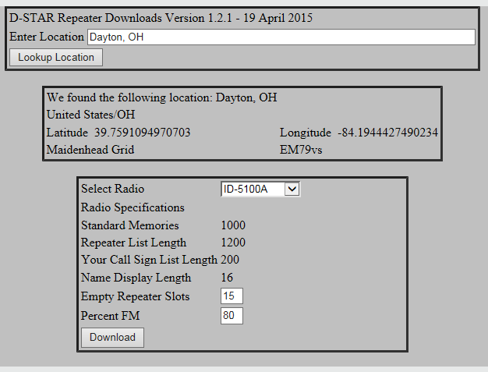
Updating Repeater List (DR)
ID-31, ID-51, ID-5100
Select Downloads, Repeater List Downloads
Provides geocoded Repeater List centered around location
Adjusts for number of memories by radio
Allows empty slots for custom or DVAP entries
Select mix of FM and DV repeaters (ID-51+, ID-5100)
Save as multiple CSV files on SD Card for import

Slide 27
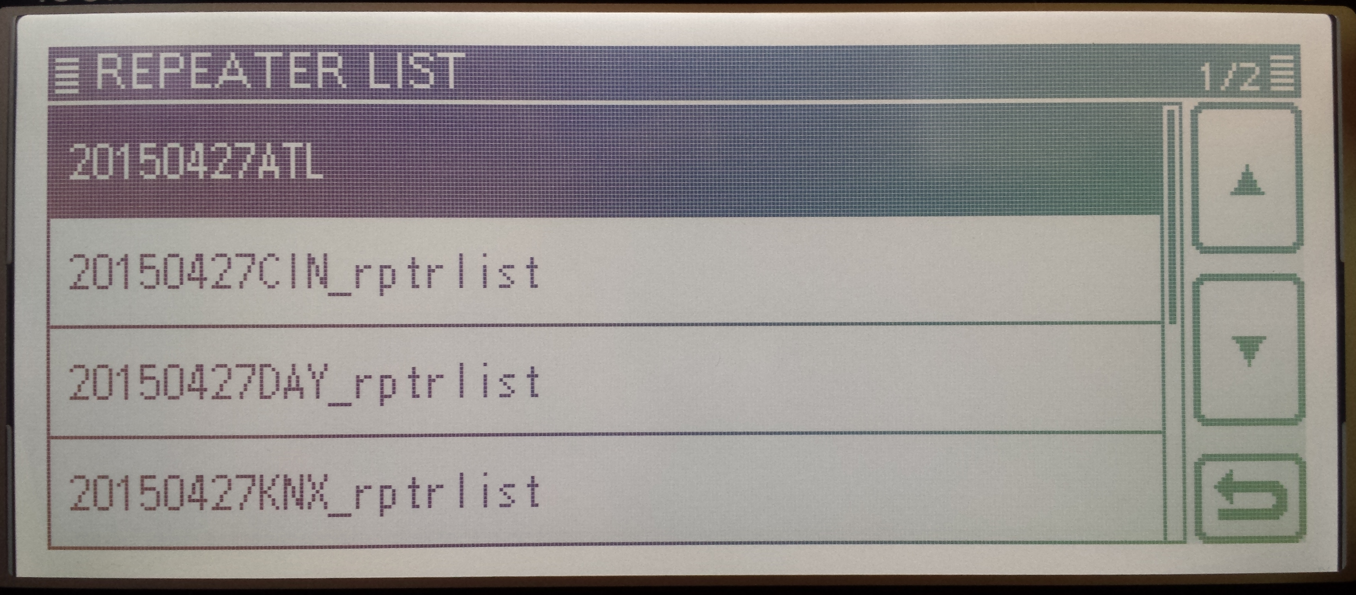
Select Repeater List on SD
ID-31, ID-51, ID-5100
Many Repeater Lists can be saved on SD Card in radio
Have a new file for each area, import as needed

Slide 28
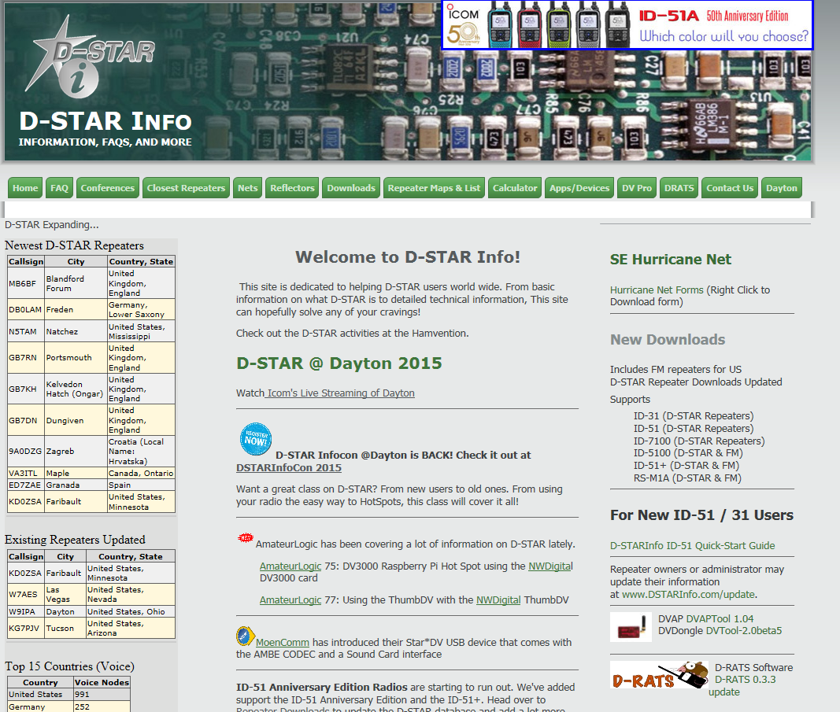
Getting Help
Website: www.DSTARinfo.com
Email: info@dstarinfo.com

